Slide 1

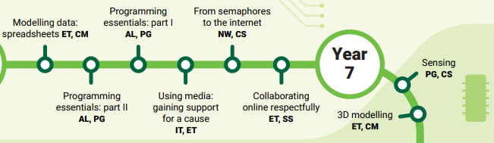
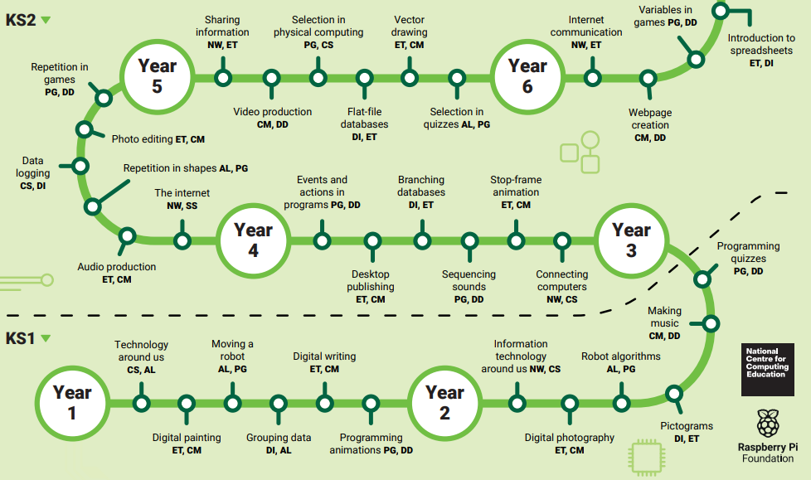








Computing Roadmap
Mechanical toys
Play activities
Video clips
EYFS
Music
Internet
Explore technology

