Slide 1

A0100

Slide 2


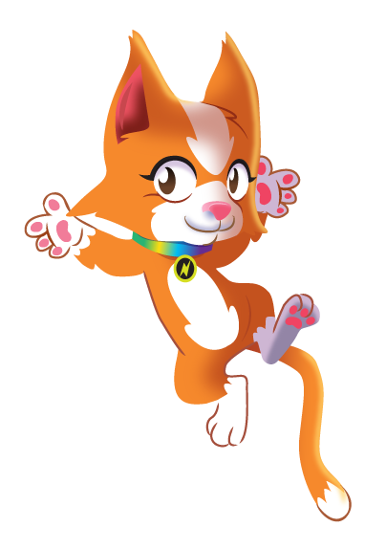

At the heart of
Power Maths
is the belief that all children can achieve.
It’s built on an exciting growth mindset and
problem-solving approach.
Notes:
Power Maths is an interactive, whole-class teaching model.
It encourages precise mathematical language and allows children to deepen their understanding as far as they can.
By working hard, all children can achieve.

Slide 3
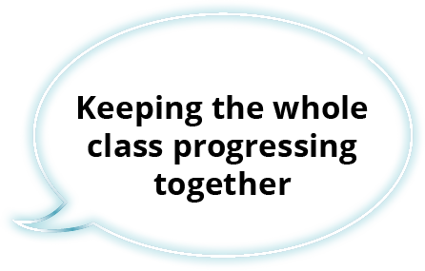
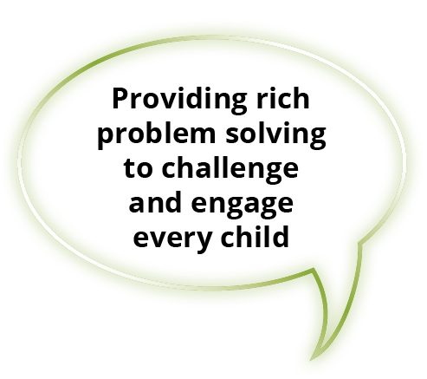
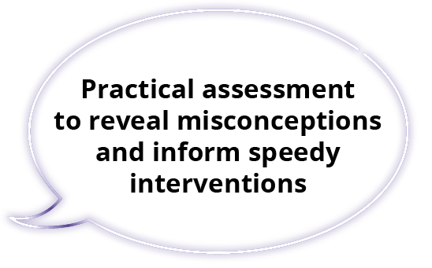

Key aims of Power Maths
Notes:
Builds every concept in small, progressive steps to help keep the whole class together.
Helps children problem-solve by building on prior learning to help them see connections and patterns.
Teachers can check understanding throughout the lesson to ensure all children are keeping up.
Power Maths aims to spark curiosity and encourages rich mathematical talk.

Slide 4

In a nutshell …
An exciting whole-class mastery approach for Reception to Year 6
Written by mastery experts and inspired by best practice from around the world
Fully recommended by the Department for Education
Created specifically for UK classrooms
Makes maths an adventure and helps build a culture of excitement and confidence!
Notes:
Power Maths is aligned with the National Curriculum, and is a whole-class mastery resource to empower every child to understand and succeed in maths.

Slide 5


What is mastery?
“Mastering maths means acquiring a deep, long-term, secure and adaptable understanding of the subject” – NCETM
We achieve this by …
Carefully
sequenced,
small step
learning
Representation
that expose
mathematical
structures
Developing
mathematical
thinking
Building
fluency

Slide 6
Growth mindset
Fixed mindset
Growth mindset
“I’m not good at maths – I’ve never been good at maths”
“I’m finding maths hard now, but I can improve with time and effort”
“I give up – I can’t make this any better”
“I can improve if I keep trying”
“If I fail I am a failure”
“Most successful people fail along
the way”
“I can’t do this – I keep making mistakes”
“Mistakes help me learn”
Notes:
The growth mindset approach encourages children to see mistakes as learning opportunities. It promotes hard work and practice, and discourages the idea that some people ‘can’t do maths’.

Slide 7

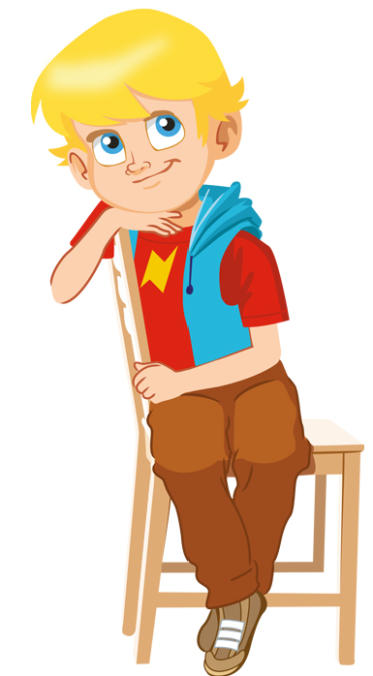
Meet the growth-mindset characters!
Flo
Flo is flexible and creative. She often with new methods to solve problems.
Dexter
Dexter is determined. When he makes a mistake he learns from it and tries again.
Can we do it differently?
Let’s try again!
Notes:
The growth mindset characters help build mathematical confidence so every child can reach their potential.
They are allies for our children and are all hard-working, enthusiastic and unafraid of making mistakes!

Slide 8
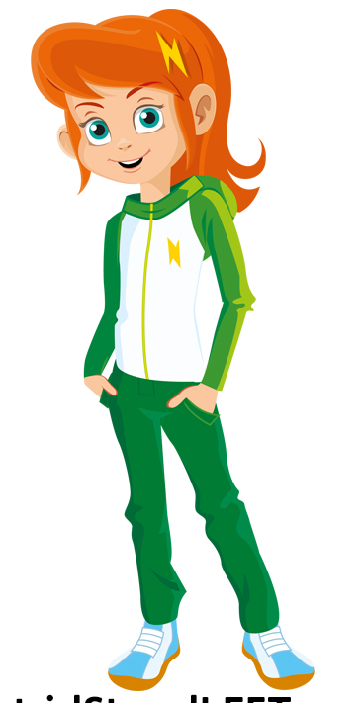
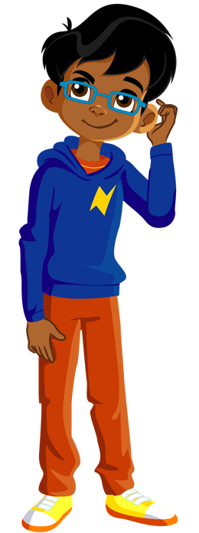
Meet the growth-mindset characters!
Astrid
Astrid is brave and confident. She is not afraid to make mistakes.
Is there a pattern?
I will share my ideas!
Ash
Ash is curious and inquisitive. He loves to explore new concepts

Slide 9
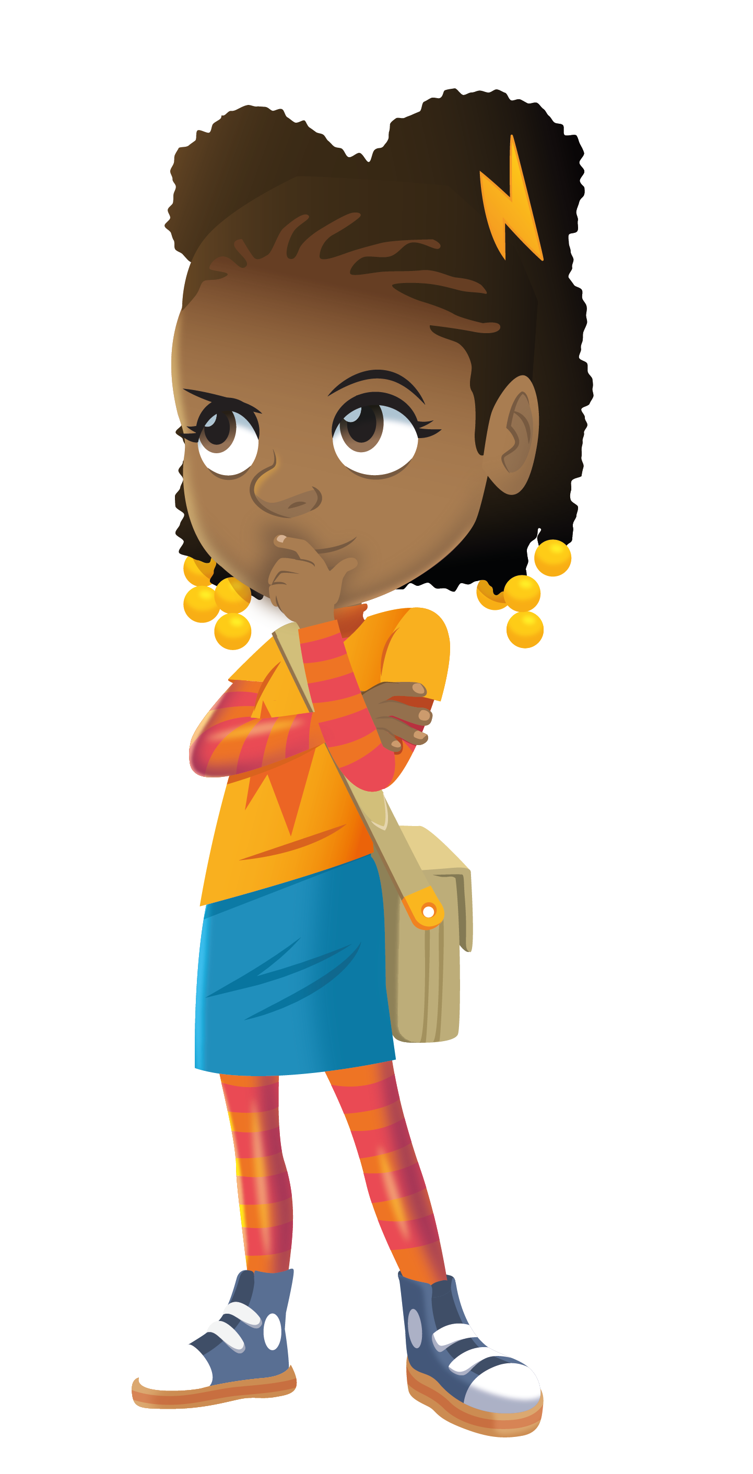
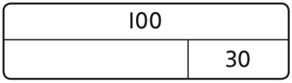
Models and representations
Part-whole models
Shows how numbers can be split into parts. Helps show the connection between addition and subtraction.
7
3
Bar models
Helps show
the maths
problem as
a picture.
Notes:
Children will be meeting mathematical models and representations which you might not yet be familiar with. Here are two examples: a part-whole model and a bar model.
These models help children to visualise the problem and explain their working.

Slide 10
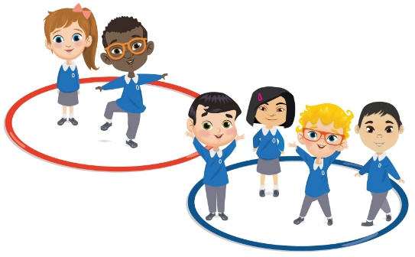
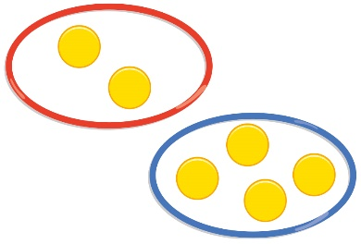
Models and representations
2
6
2 + 4 = 6
4
Notes:
Children are encouraged to solve problems each day through the use of concrete resources, pictorial representations and abstract thinking (the C-P-A approach). This helps children tackle concepts in a tangible and more comfortable way.
C = Concrete. A familiar object that a child can manipulate to help bring the maths to life. Children make the connection between the number and the object. It could be cakes, cars or children!
P = Pictorial. This uses pictorial representations and diagrams of objects to ‘see’ what maths problems look like. This might be drawn counters which represent each child in the maths problem.
A = Abstract. The ultimate goal is for children to understand abstract mathematical concepts and symbols.

Slide 11

A0100
Notes:
We hope your children enjoy working with Ash, Dexter, Astrid and Flo to master maths.

