Slide 1

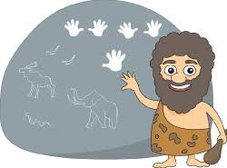
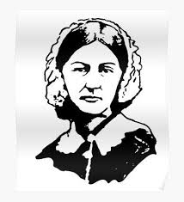
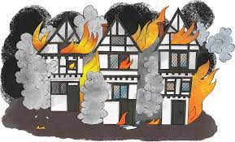
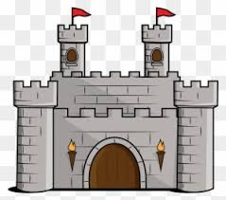
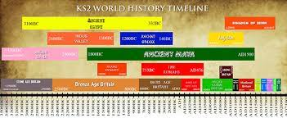
Trefonen CE Primary School
History Learning Journey - New V.1
High School
Our History curriculum helps pupils to gain a coherent knowledge and understanding of Britain’s past and that of the wider world. Through the units studied, we seek to inspire childrens’ curiosity to know more about the past.
Children are helped to develop their understanding of the complexity of people’s lives, the process of change, the diversity of societies and relationships between different groups, as well as their own identity and the challenges within their time.
Children are encouraged and supported to ask perceptive questions, think critically, weigh evidence, sift arguments, and develop perspective and judgement.
Children take part in a wide range of History workshops and regularly visit Shrewsbury Museum to help them learn how to use artefacts.
Children take part in video drama workshops (UNO)
Spring Term
Year A: WWII & The Blitz
What was the impact of World War II & how significant was the Blitz on people in our locality?
What it was like to be an evacuee?
Year B: The Shang Dynasty
What do artefacts tell us about life in Shang times? What do we still need to know and where might we find the answers to our questions?
Summer Term:
Year A: Local History
What does the Lime Works Heritage site tell us about how local people lived?
Year B: The Benin Empire:
What is Africa’s Big Picture? If objects could speak what story would they tell?
Autumn Term
Year A: The Romans
When did the Romans invade and why?
Did the native Britons welcome or resist the Romans, and why? How did the Romans influence the culture of the people already here?
Year B: Anglo-Saxons & Vikings
What was life really like in Anglo-Saxon and Viking Britain? What did the Anglo-Saxons and Vikings leave behind?
Children are taught about the different methods of historical enquiry, including how evidence is used to make historical claims, and how and why different arguments and interpretations of the past have been made.
Hawks Class
Summer Term:
Year A:The Georgians
How did trade shape and develop Georgian society? What does the work of significant individuals tell us about the period?
Year B: Early Islam, Including Baghdad
How different was Baghdad to London around 900AD?
What was the House of Wisdom?
Who was Ibn Battuta and how did he help us? What can we learn from Muslim medicine & what did early Islamic civilization leave behind?
Spring Term
Year A: Local History
Who were Trefonen’s Local Heroes? What was the impact of WW II on our locality?
Year B: The Indus Valley
Who were the Indus people and what were their lives like? How do we know? What did they invent? What happened to them?
Autumn Term
Year A: Ancient Greece
How can we find out about the civilization of Ancient Greece? Can we thank Ancient Greece for anything in our lives today?
Year B: Anglo-Saxons, Vikings & Scots
Who were the Anglo-Saxons & why did they invade & settle in Britain?
How well did the Anglo-Saxons & Vikings get on with each other?
Children will be helped to understand and use the important key concepts of Historical enquiry historical: (Second Order Concepts)
Chronology,
Diversity,
Continuity and Change, Cause and Consequence, Similarity & Difference, Significance,
Interpretation,
Evidence & Sources.
Children gain historical perspective by placing their growing knowledge into different context and making connections.
.
p
Puffins Class
Autumn Term
Year A: Stone Age to Iron Age
What was ‘new’ about the Stone Age?
Which was better, bronze or iron?
When do you think it was better to live – Stone Age, Bronze Age or Iron Age?
Year B: Local History: Victorian Trefonen
How has Trefonen Changed since Victorian times?
Spring Term:
Year A: Ancient Sumer
Where and when was Ancient Sumer? What was everyday life like? How do we know? What did they invent?
What happened to them?
Year B: The Elizabethans
What do we understand by Elizabethan times? How safe was it? What was it like to live in Elizabethan times?
Summer Term:
Year A: The Maya
Where and when did they live? What were their lives like? What did they invent?
How do we know?
Year B: Ancient Egypt
How did the civilisation of Egypt wax & Wane?
Children will be supported to identify and make connections between the common threads within and across the different units that they study.
We have identified these as:
Agriculture, Civilization, Empire,
Government, Industry, Monarchy, Religion, Trade, War.
(First order concepts)
Wrens Class
.
Summer Term: Local History
Year A: Why were Castles Important in our local area?
Year B: Our Village & Our Town:
Trefonen & Oswestry
Spring Term: Significant Individuals
Year A & Year B:
Children will explore several ‘Significant Individuals’ and explore their significance / the concept of significance.
(The specific significant individuals are chosen each year, taking into account relevance and interest e.g. Florence Nightingale & Mary Seacole, The Wright Brother & Amy Johnson, Amelia Earhart, Grace Darling, Mary Anning, Columbus
Autumn Term::Significant Events
Year A: Great Fire of London
What happened on the night of 2 September 1666 and Why?
Year B: Man’s First Moon Landing:
Neil Armstrong & Christopher Columbus
Was Columbus an Explorer or an Exploiter?
In KS 1 children will learn about: History Vocabulary, Chronology, Changes within Living memory, Significant Events, Significant Individuals, Local History
Nightingales
Class
Autumn Term
People and their Roles in Society:
Significant Events:
The Gunpowder Plot
Remembrance Day
Spring Term
Similarities and differences between things in the past and now
Summer Term
How do stories help us to understand the past?
Robins
Class
Sometimes we will change our unit of study, if there is a particular significant event that is happening locally, nationally or globally
e.g The King’s Coronation
Summer term: LOVE FREEDOM INDEPENDENCE FAMILY VALUES

