Slide 1
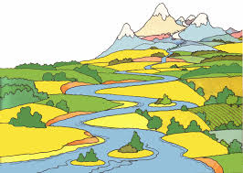

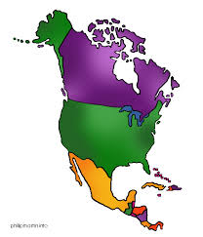



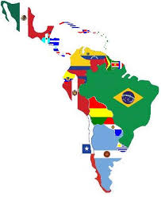

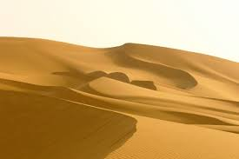
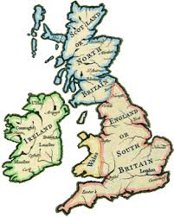
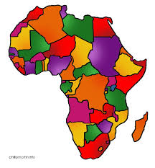
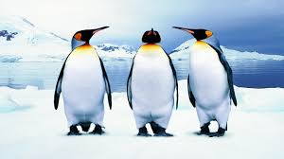

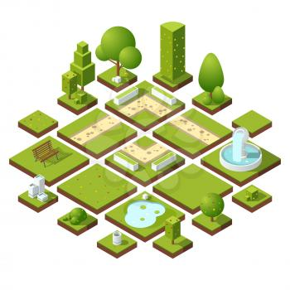
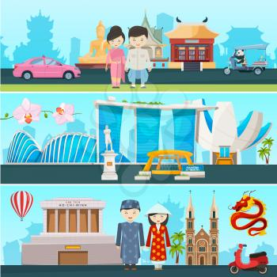
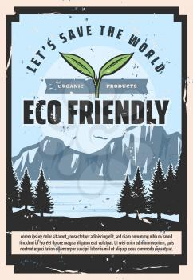
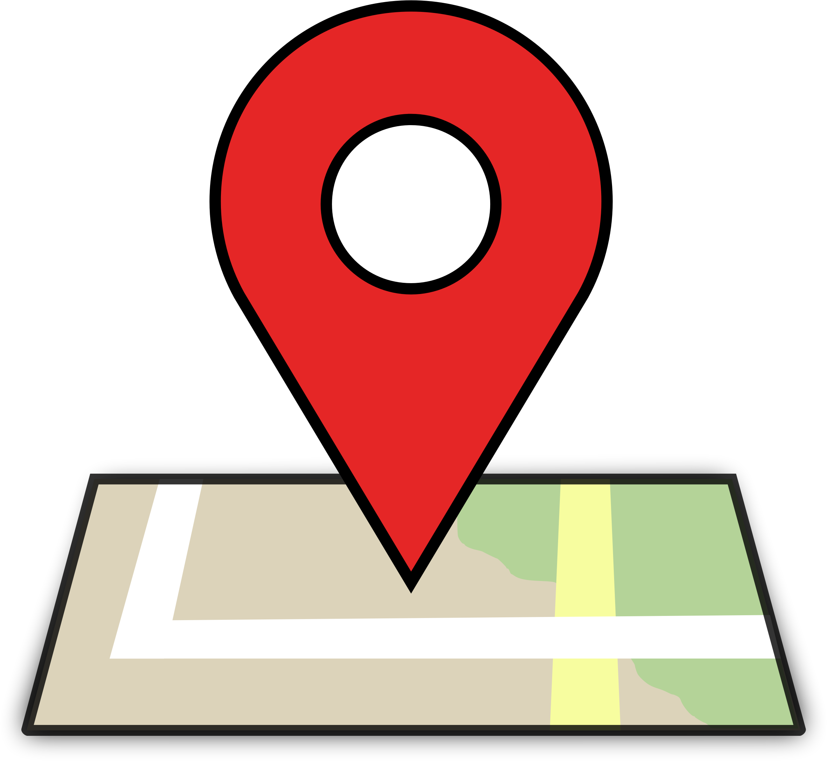
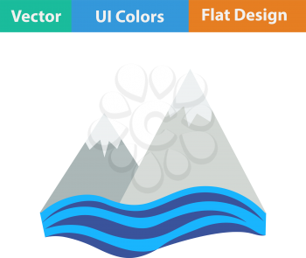
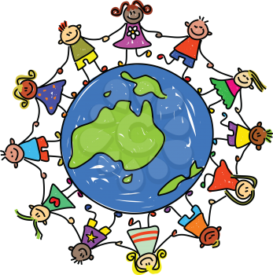
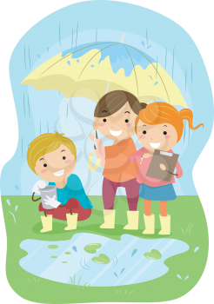
Our Geography Learning Journey (Updated January 2025 )
Through geography we unravel the wonder of people, places and environments. It is our intent to stimulate our children to be curious about their own area and the wider world. We want our pupils to have a desire to explore and investigate people, places and the environment and to develop the skills and knowledge to be able to do so. We intend for pupils to enjoy and value what they see around them and have concern for their future. We want our pupils to have a real love of geography.
What is life like in a city? How does Liverpool compare to our local town of Oswestry?
Is Austria a good place to holiday?
How important are rivers to people? Why is Lake Vyrnwy so important to the people of Liverpool? How can rivers affect us? Can we manage them?
Hawks Class
Year A Region of the UK- Liverpool Merseyside
Autumn
Year B Hills and Mountains
Year A European Region- Central Europe -Austria
Spring
Year B Global Goals
Year A Rivers and the Water Cycle
Summer
Year B South America- The Amazon Basin
Where are the UK’s National Parks? Who are they for and how can we protect them?
What are the world’s leaders doing to protect our world?
Why should rainforest be important to us all? Should we allow them to be destroyed?
Children in Puffins class work towards achieving the John Muir discovery Award
Why does the river Severn flood?
How would living in Poland compare to living in the UK?
How is the town of Llandudno in North Wales different to our local town and Shropshire?
Year A Rivers and the Water Cycle
Summer
Year B North America
Year A European Region- Eastern Europe Poland
Spring
Year B Climate Change
Year A Region of the UK- North Wales
Autumn
Year B Mountains and Volcanoes
Throughout Year A in Wrens, we explore how we can protect Antarctica.
p
An American road trip.
Why is Canada not a part of the USA?
Climate change – What is happening to our beautiful world? Can we help?
How do Earthquakes change the World?
Puffins Class
Why do we love to be beside the seaside? How is Trefonen, Shropshire similar and different to New Brighton The Wirral?
Why do so many people head to the Med on holiday?
How does a river change along its course and how does water go round and round?
Year A Region of the UK- The Wirral
Autumn
Year B Hills, Mountains and Volcanoes
Year A European Region –Southern Europe The Mediterranean
Spring
Year B How can we help to protect Antarctica?
Year A Rivers and the
Water Cycle
Summer
Year B South America – South East Brazil
Wrens Class
What is a hill? What is a mountain?
Why would people choose to live by a volcano?
How are we affecting Antarctica? Can we live more sustainably? What is climate change?
What would it be like to live in Brazil? What is it like in a rainforest?
Continents and Oceans
Local Area
Hot and Cold Places
Key Stage One
Year B
What is an ocean? What is a continent?
What is it like in the place where I go to school?
Where are the world’s hot and cold places? What is it like there?
Autumn
Spring
Summer
Key Stage One
Year A
Weather and Climate
The United Kingdom
Contrasting
Non-European Locality- Zambia
Key Stage
One
How does weather change throughout the Year?
What is the
United Kingdom?
What would it be like to live in a Zambian Village?
Develop knowledge and sense of world around them
New vocabulary
Similarities and differences between life in this country and in others
The natural world and how to care for it
Simple mapping
Early Years Foundation Stage
Location of
our school
Draw own maps of real and imaginary places
Comparing contrasting environment
Seasons and their affects on the world around them
The Geography key concepts that will be developed throughout children’s Geography journey.
Place
Human
Cultural Understanding
Environmental and
sustainable development
Location
Physical processes
Interdependence
Geography skills and fieldwork

