Slide 1
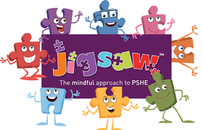



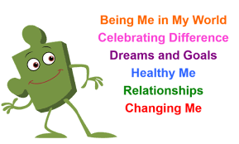
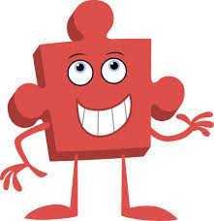

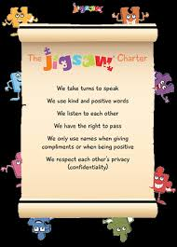
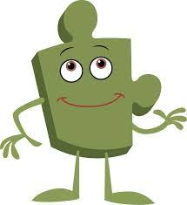
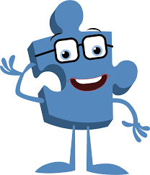


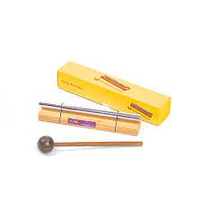
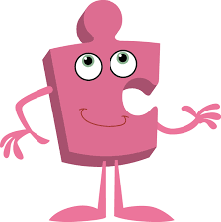
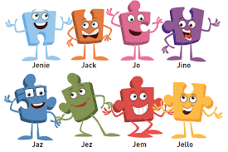

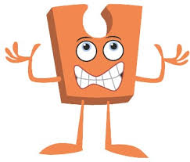

Trefonen CE Primary School
PSHE / RSE Learning Journey V.1
The foundation of our school’s PSHE/ RSE curriculum is our whole school Values Curriculum.
Our school’s specific PSHE / RSE curriculum follows the Jigsaw Scheme of Work for PSHE and the Shropshire Respect Yourself programme for RSHE/RSE
as our core resources. These resources are supported further through our Happy Centred School Programme and Picture News.
The 6 key themes that we study in PSHE / RSE are:
Autumn 1
Being Me in My World:
Identifying goals for the year
Global citizenship
Children’s universal rights
Feeling welcome and valued Choices, consequences and rewards Group dynamics
Democracy, having a voice
Anti-social behaviour
Role-modelling
Autumn 2
Celebrating Difference:
Perceptions of normality
Understanding disability
Power struggles
Understanding bullying
Inclusion/exclusion Differences as conflict,
difference as celebration
Empathy
Spring 1
Dreams & Goals:
Personal learning goals, in and out of school Success criteria
Emotions in success
Making a difference in the world
Motivation
Recognising achievements
Compliments
Spring 2:
Healthy Me:
Taking personal responsibility
How substances affect the body Exploitation, including ‘county lines’ and gang culture Emotional and mental health
Managing stress
Summer 1:
Relationships:
Mental health
Identifying mental health worries and sources of support Love and loss
Managing feelings
Power and control
Assertiveness
Technology safety
Take responsibility with technology use
Summer 2:
Changing Me:
Self-image
Body image
Puberty and feelings
Conception to birth
Reflections about change
Physical attraction
Respect and consent
Boyfriends/girlfriends
Sexting
Transition
High School
Rota Kids
We have lots of special workshops that take place through the year:
e.g.
Flat Stan First Aid
Hand Hygiene
Sleep
Resilience
Emotional Well-being
Happiness
Hi,
I’m Jem
Hawks Class
Children in Need
Comic Relief
Summer 2:
Changing Me:
Self- and body image
Influence of online and media on body image
Puberty for girls
Puberty for boys
Conception (including IVF)
Growing responsibility
Coping with change
Preparing for transition
Summer 1:
Relationships:
Self-recognition and self-worth
Building self-esteem
Safer online communities
Rights and responsibilities online
Online gaming and gambling
Reducing screen time
Dangers of online grooming
SMARRT internet safety rules
Spring 2:
Healthy Me:
Smoking, including vaping
Alcohol
Alcohol and anti-social behaviour
Emergency aid
Body image
Relationships with food
Healthy choices
Motivation and behaviour
Spring 1
Dreams & Goals:
Future dreams
The importance of money
Jobs and careers
Dream job and how to get there
Goals in different cultures
Supporting others (charity)
Motivation
Autumn 2
Celebrating Difference:
Cultural differences and how they can cause conflict
Racism
Rumours and name-calling
Types of bullying Material wealth and happiness
Enjoying and respecting other cultures
Autumn 1
Being Me in My World:
Planning the forthcoming year
Being a citizen
Rights and responsibilities
Rewards and consequences
How behaviour affects groups Democracy, having a voice, participating
Anti- Bullying Week
Children’s mental Health Week
p
Hi,
I’m Jez
Our Jigsaw Charter
Puffins Class
School Council
Autumn 1
Being Me in My World:
Setting personal goals
Self-identity and worth
Positivity in challenges Rules, rights and
responsibilities
Rewards and consequences
Responsible choices Seeing things from others’ perspectives
Autumn 2
Celebrating Difference:
Families and their differences
Family conflict and how to manage it (child-centred) Witnessing bullying and how to solve it
Recognising how words can be hurtful
Giving and receiving compliments
Spring 1
Dreams & Goals:
Difficult challenges and achieving success
Dreams and ambitions
New challenges
Motivation and enthusiasm Recognising and trying to overcome obstacles
Evaluating learning processes
Managing feelings
Simple budgeting
Spring 2:
Healthy Me:
Exercise
Fitness challenges
Food labelling and healthy swaps
Attitudes towards drugs Keeping safe and why it’s important online and off line scenarios
Respect for myself and others
Healthy and safe choices
Summer 1:
Relationships:
Family roles and responsibilities
Friendship and negotiation
Keeping safe online and who to go to for help
Being a global citizen
Being aware of how my choices affect others
Awareness of how other children have different lives
Expressing appreciation for family and friends
Summer 2:
Changing Me:
How babies grow
Understanding a baby’s needs
Outside body changes
Inside body changes
Family stereotypes
Challenging my ideas
Preparing for transition
Hi, I’m Jino
Wrens Class
.
British Values: Mutual Respect, Democracy, Tolerance of Different Faiths & Beliefs, the Rule of Law, Individual Liberty
Summer 2:
Changing Me:
Life cycles in nature
Growing from young to old
Increasing independence Differences in female and male bodies (correct terminology)
Assertiveness
Preparing for transition
Summer 1:
Relationships
Different types of family
Physical contact boundaries
Friendship and conflict
Secrets
Trust and appreciation
Expressing appreciation for special relationships
Spring 2:
Healthy Me:
Motivation
Healthier choices
Relaxation
Healthy eating and nutrition Healthier snacks and sharing food
Spring 1
Dreams & Goals:
Achieving realistic goals
Perseverance
Learning strengths
Learning with others
Group co-operation
Contributing to and sharing success
Autumn 2
Celebrating Difference:
Assumptions and stereotypes about gender Understanding bullying Standing up for self and others
Making new friends
Gender diversity
Celebrating difference and remaining friends
Autumn 1
Being Me in My World:
Hopes and fears for the year
Rights and responsibilities
Rewards and consequences Safe and fair learning environment
Valuing contributions
Choices
Recognising feelings:
NSPCC PANTS
NSPCC PANTS
Harvest Food Bank Collection
Hi,
I’m Jo
Our Jigsaw Friends
Hi,
I’m Jack
Nightingales
Class
Jerry Cat
The Chime
Autumn 1
Being Me in My World:
Feeling special and safe
Being part of a class
Rights and responsibilities
Rewards and feeling proud
Consequences
Owning the Learning Charter
:
Autumn 2
Celebrating Difference:
Similarities and differences Understanding bullying and knowing how to deal with it Making new friends
Celebrating the differences in everyone
Spring 1
Dreams & Goals:
Setting goals
Identifying successes and achievements
Learning styles
Working well and celebrating achievement with a partner Tackling new challenges Identifying and overcoming obstacles
Feelings of success
Spring 2:
Healthy Me:
Keeping myself healthy
Healthier lifestyle choices
Keeping clean
Being safe
Medicine safety/safety with household items
Road safety
Linking health and happiness
Summer 1:
Relationships
Belonging to a family
Making friends/being a good friend
Physical contact preferences
People who help us
Qualities as a friend and person
Self-acknowledgement
Being a good friend to myself
Celebrating special relationships
Summer 2:
Changing Me:
Life cycles – animal and human
Changes in me
Changes since being a baby Differences between female and male bodies (correct terminology)
Linking growing and learning
Coping with change
Transition
Robins
Class
Valuing all God’s Children
OUR SCHOOL VALUES:
‘RESPECT’ is our school’s over-arching value
We explore our School Value in our weekly Values whole school assembly
Every Tuesday, Rev. Kathy helps us to explore our school value further through Bible stories and Christian messages
Autumn term: COMMUNITY SHARING EMPATHY PEACE
Spring term: HAPPINESS FRIENDSHIP HOPE TRUST
Summer term: LOVE FREEDOM INDEPENDENCE FAMILY VALUES

