Slide 1
Welcome to…
Trefonen c.e. school
An information Powerpoint about starting school.

Slide 2
Welcome to school!
Dear Children and Parents/Carers,
We can’t wait to meet you and welcome you into our school! We have made a Powerpoint about Trefonen School that will help you get to know us all better.
This Powerpoint will tell you the most important things that you need to know about our school and class. We hope that you enjoy sharing this with your grown up.

Slide 3
If you have any questions please contact us via email or phone.
School contacts:
Phone: 01691 652960
Email: parentcontact@trefonen.shropshire.sch.uk
With Best Regards,
Sam Geran (Class Teacher)

Slide 4
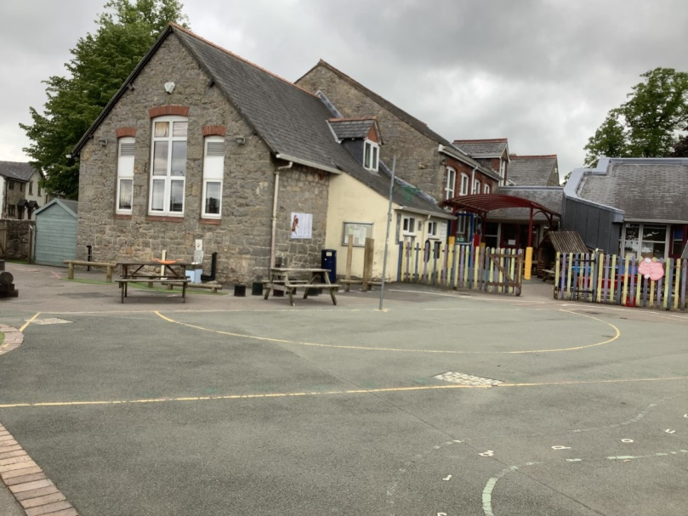
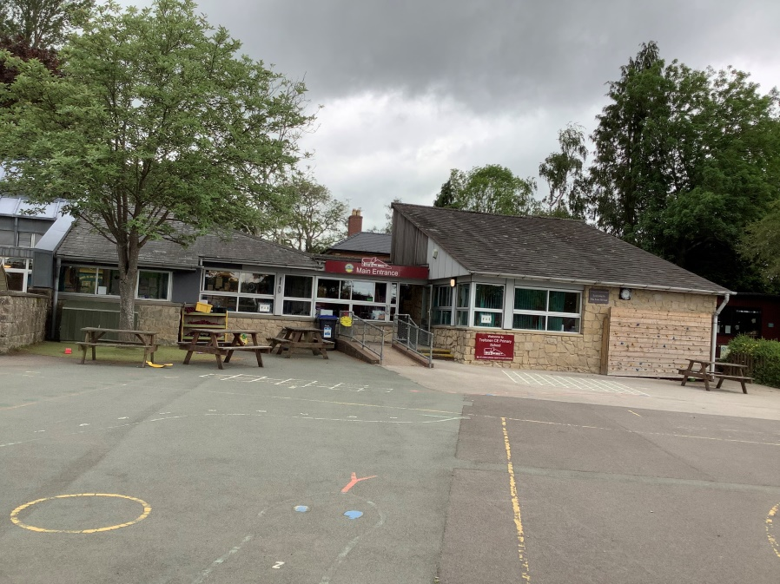
First Glance!
This is what our school looks like from the outside.

Slide 5
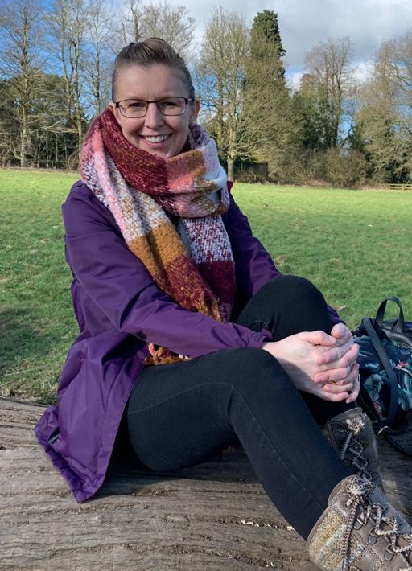
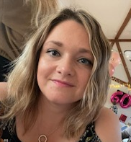
Staff in our class.
Mrs Geran is our class teacher.
Miss Delooze is our teaching assistant.

Slide 6
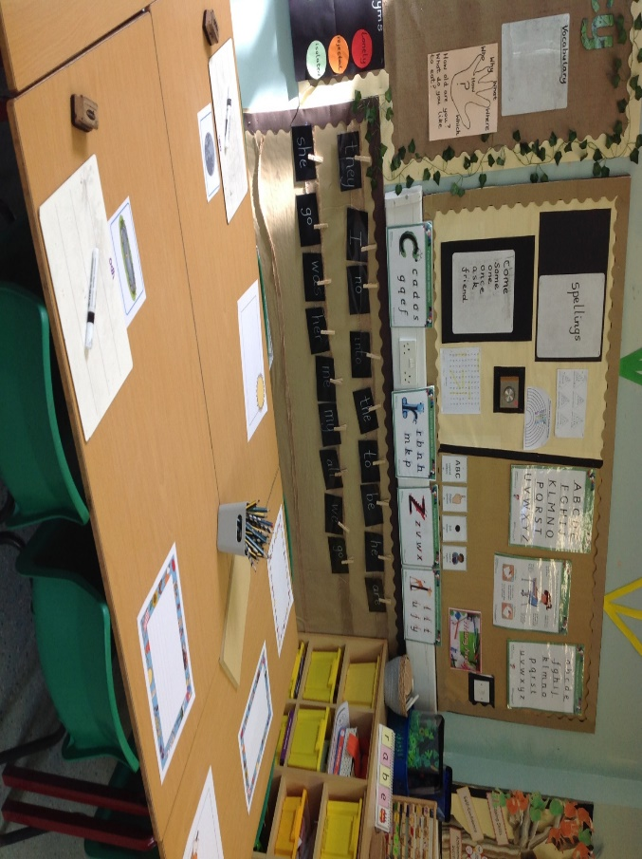
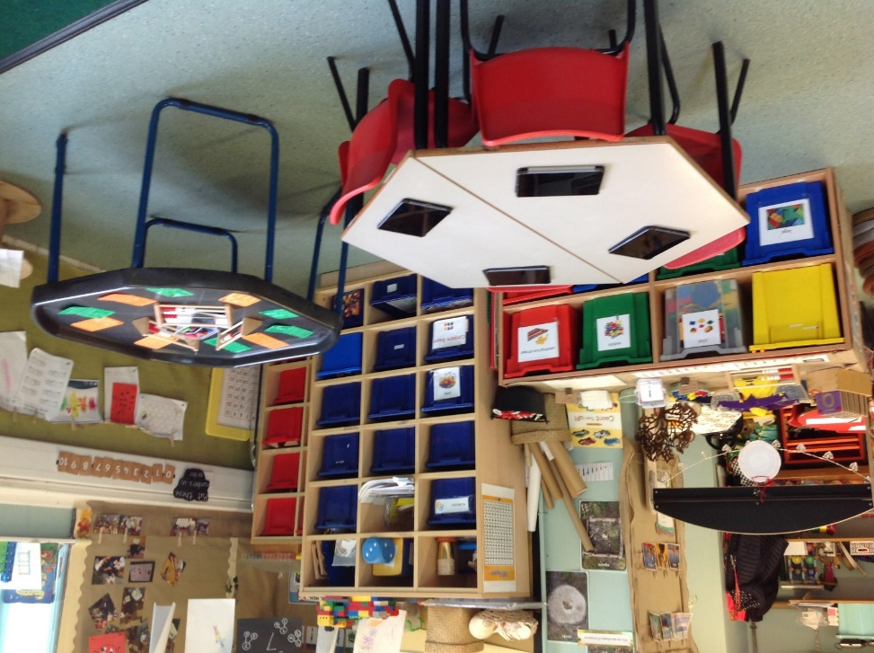
Classroom
In Robins we have both an inside and an outside learning area/classroom.
Here are some pictures of the indoor learning area.

Slide 7
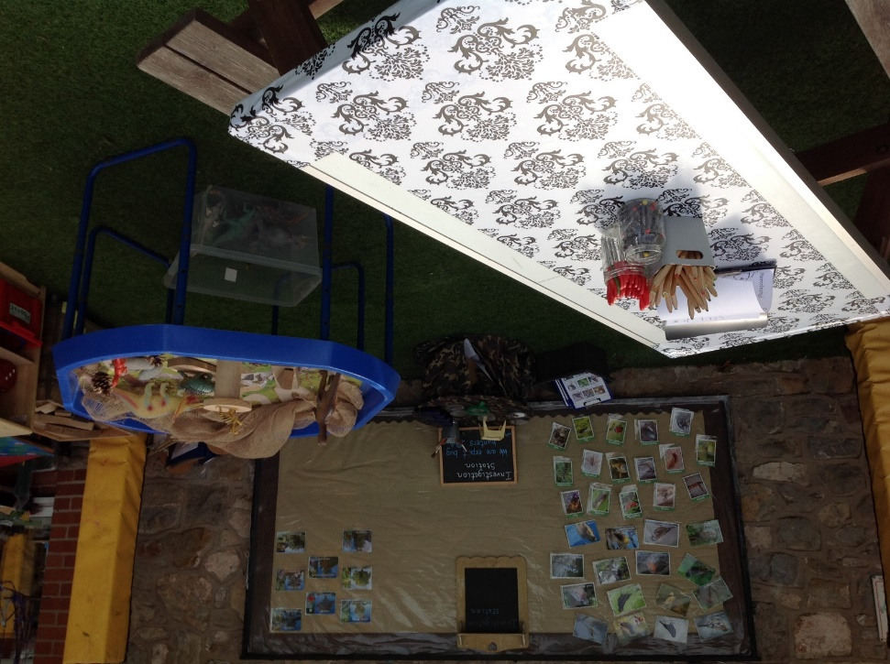
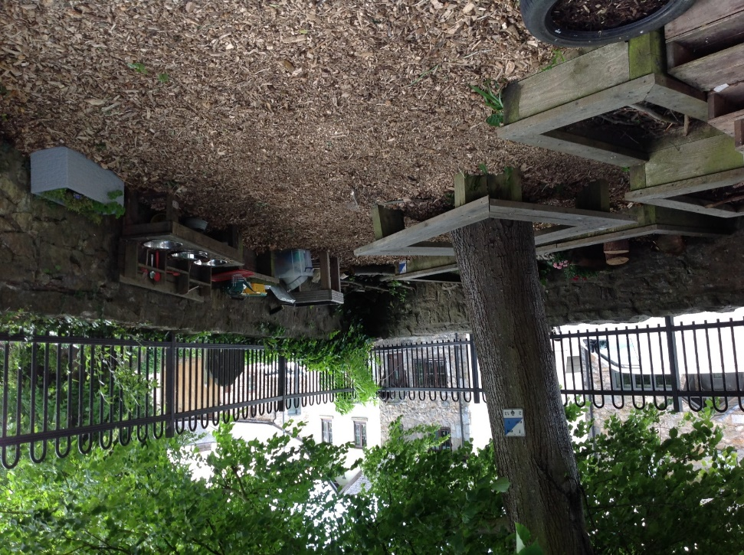
Here are some photos of our outside learning area.

Slide 8
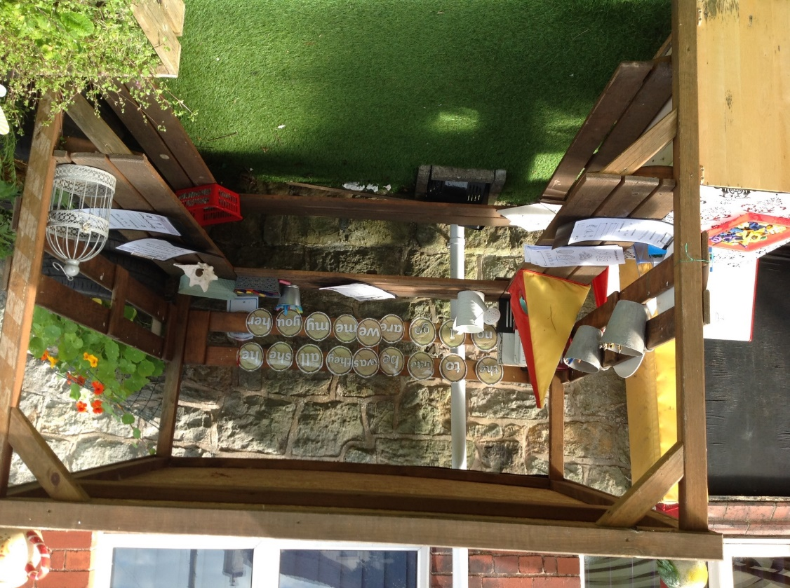
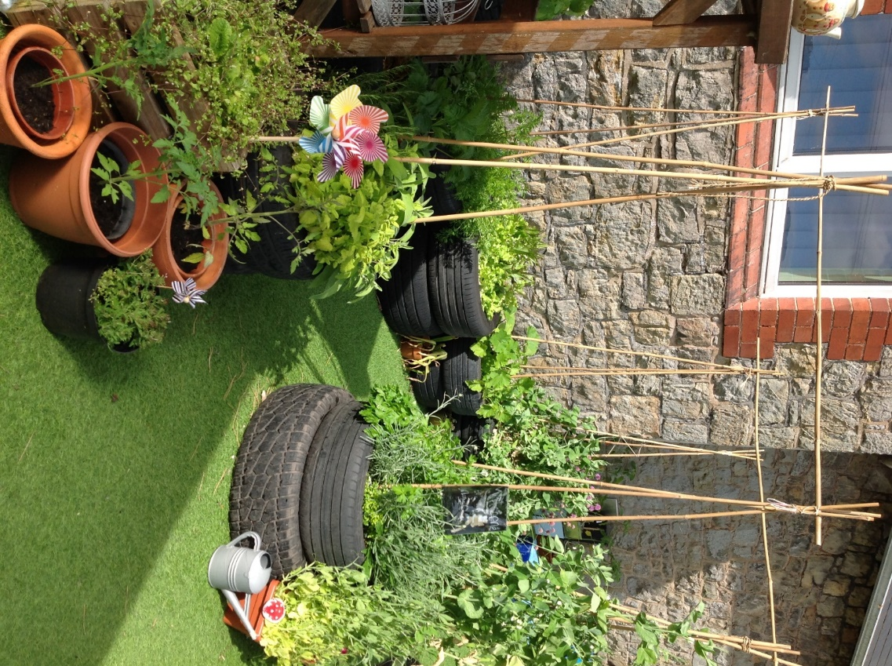
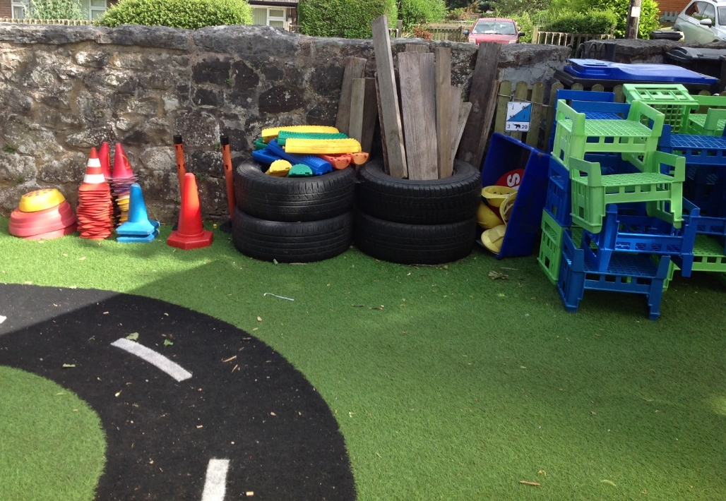

Slide 9
Daily Routines
When you come into school each morning you will need to:
Hang your coat up in the cloakroom (your peg will have your name on it).
If you have a lunchbox, it will go on the table.
Put your book bag inside your tray (which will also have your name on it).
There is a lot to remember but don’t worry! There will be grown ups there to help you remember the classroom routines.

Slide 10
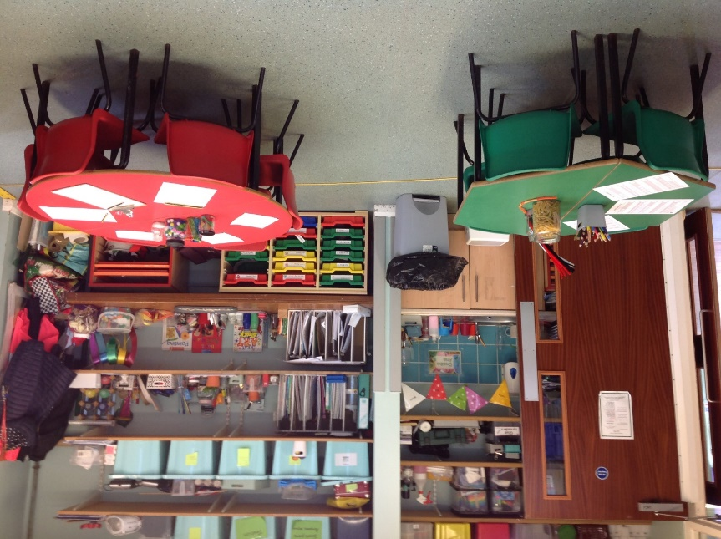
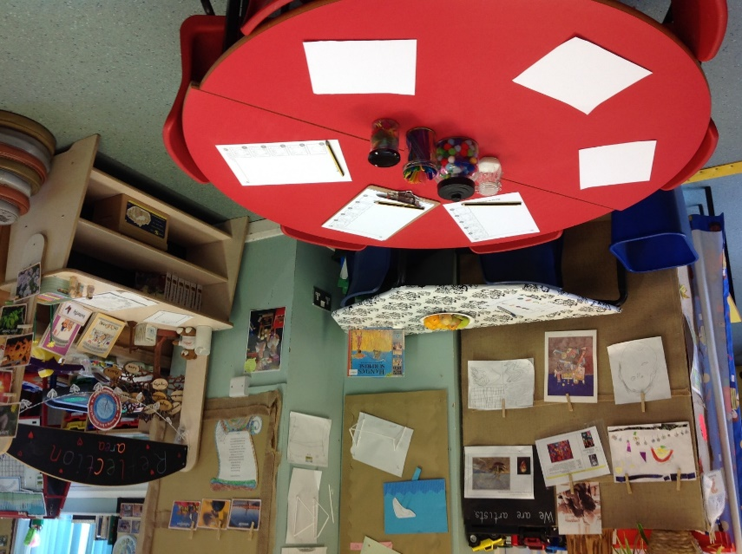
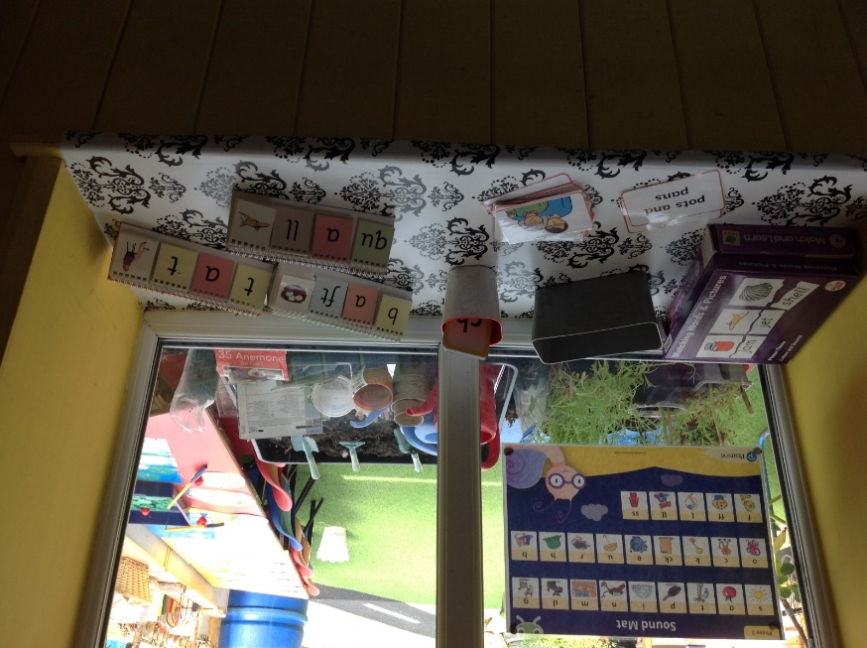

Slide 11
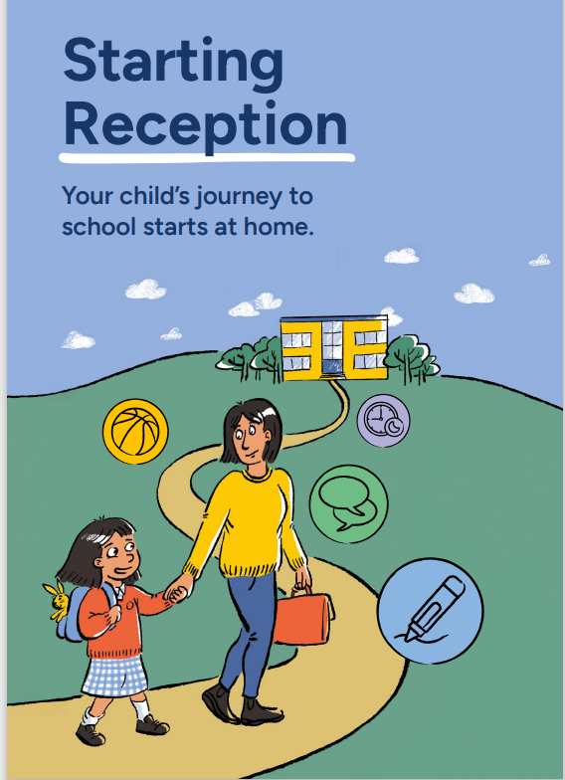
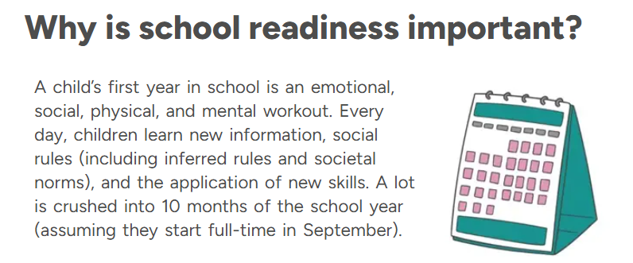
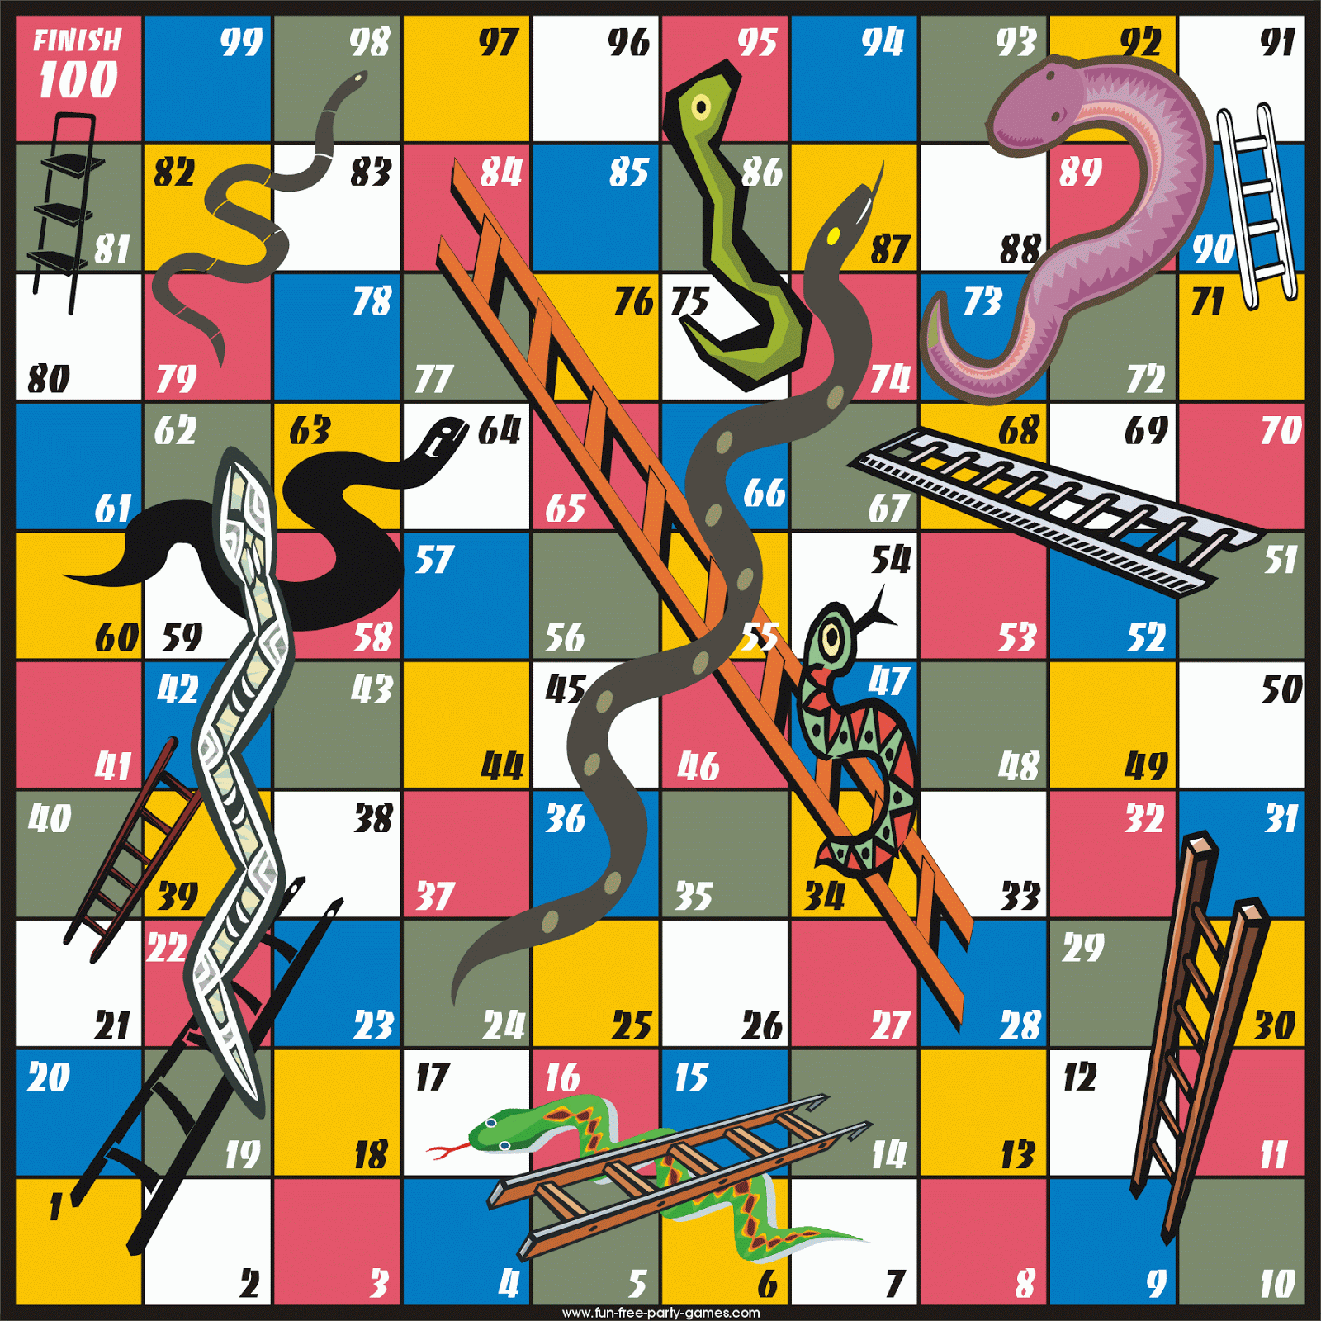
Getting ready to start school.
Here are some ways that you can help to prepare your child for school:
* Going to the toilet. Help your child to learn to go to the toilet independently, including managing their clothes and being able to wipe their own bottom.
Dress and undress independently (including fastening buttons and/or zipping up coats). Try to avoid clothing with fiddly buckles and buttons.
Take off and put on Velcro fastened shoes. Try to avoid shoes with laces.
Use a knife and fork and know how to open their own lunchbox. Also practise opening things such as yogurts, drink cartons & water bottles.
Encourage sharing-sharing toys and games and playing games such as Snakes and Ladders, which will help them to practise social skills and taking turns.

Slide 12
School Ready
Class Routines & Expectations
Be equipped – uniform, school bag, water bottle & coat. PE kit & squirrel school clothing
Be independent – ready to say goodbye. Get changed for squirrel school.
Be ready – Good nights sleep, healthy breakfast, calm morning.
*Read everyday. Record a simple comment in reading record.
Our timetable
Phonics
Literacy – handwriting, guided reading & class room story
Maths – mastering number, shape & measure
Daily Stories
PE, science, computing, Art & DT, History, Geography, PSHE, picture news
Squirrel School
cooking

Slide 13
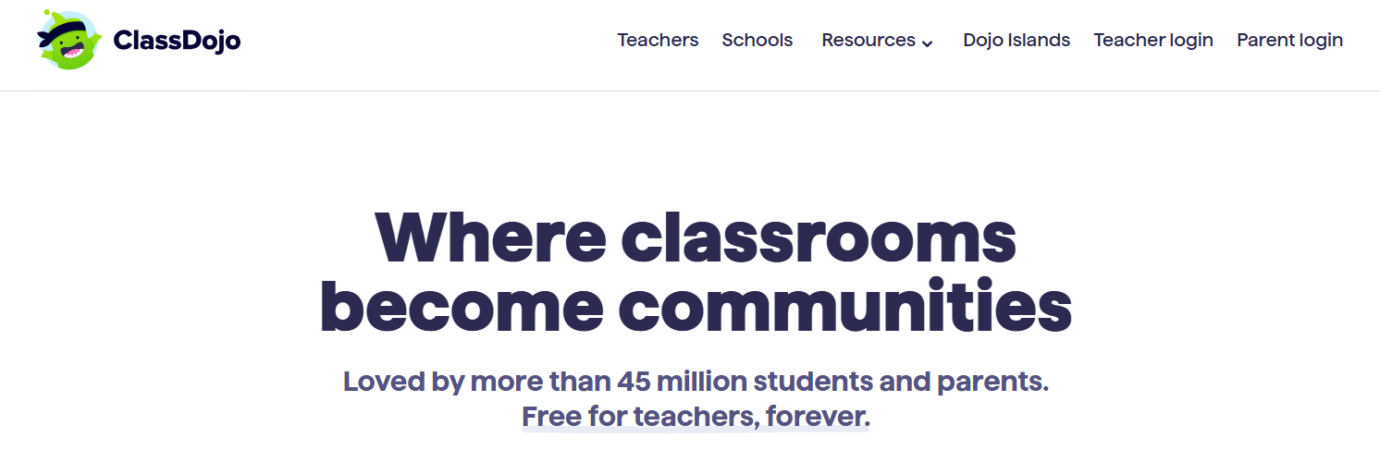
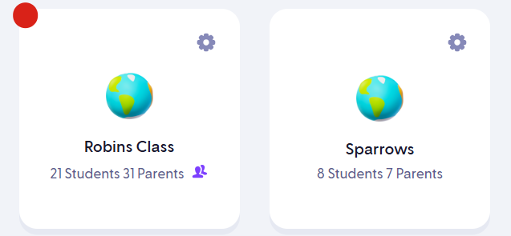
Trefonen - Ways we share information
ClassDojo
Newsletter
Website
Now
Pre School
From September

Slide 14
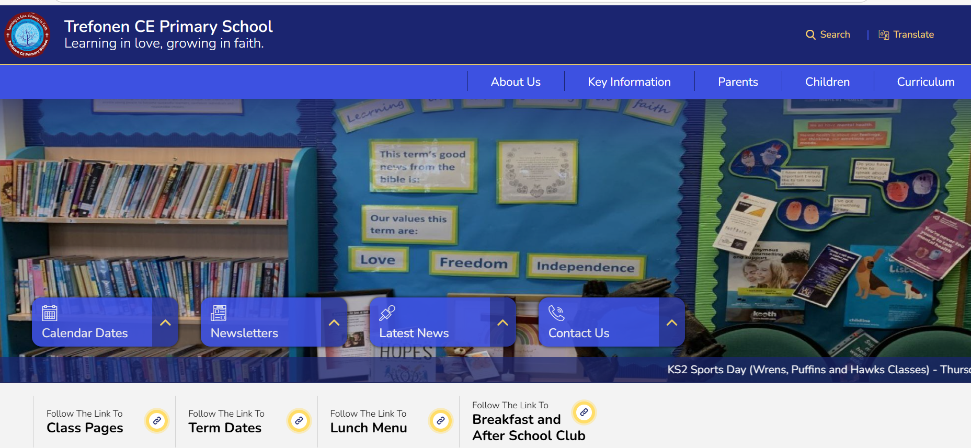
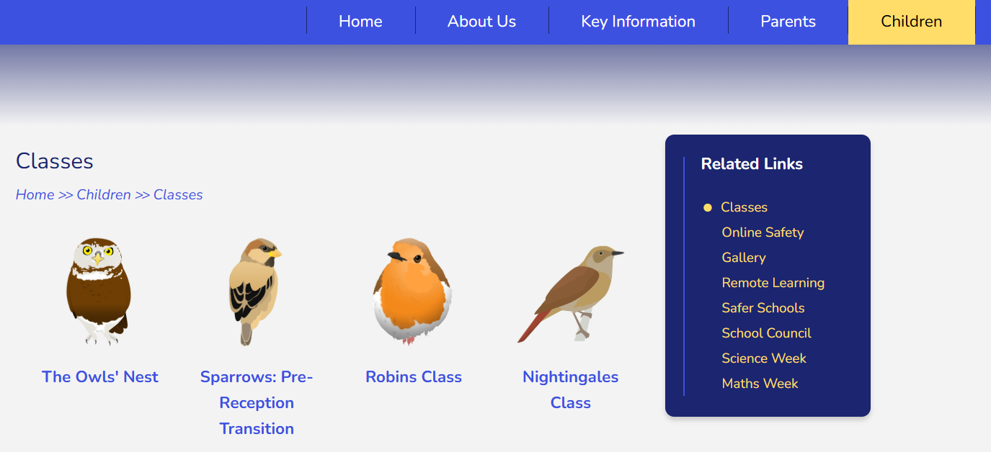
Our School Website
Newsletters
Our class info

Slide 15
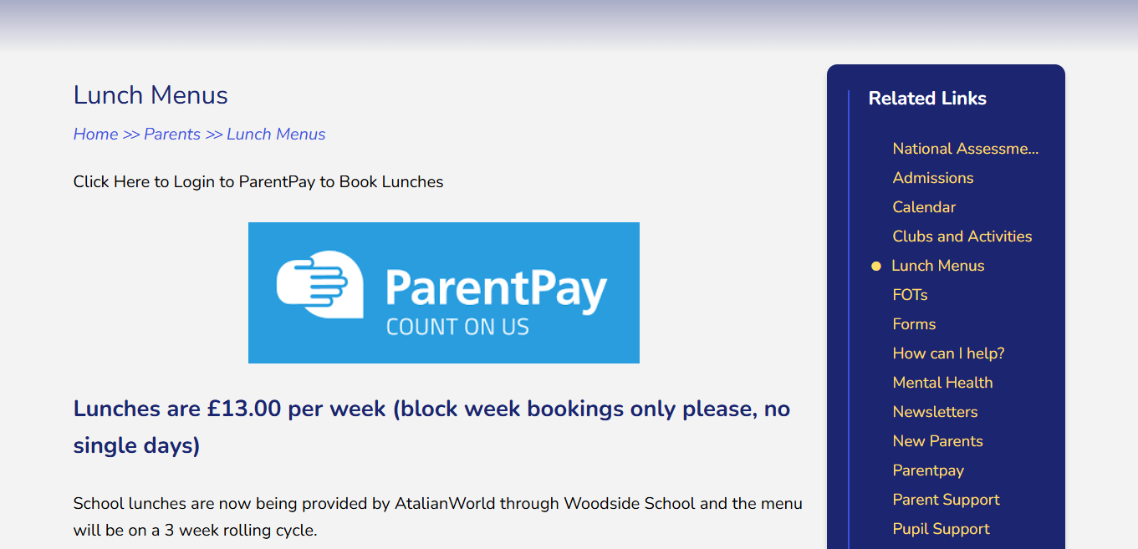
School Lunches & Parent Pay
Milk & Fruit provided daily for EYFS ( milk up to 5yrs)
Parents will be given an activation code (paper copy/ email) within the first week for Parent Pay.
First week back – Tuesday 2nd Sept. Please let the office know via email before end of this term if possible. Book a week at a time Monday to Friday.

Slide 16
Additional information
School bag will be provided and given on transition days.
Please label school clothes especially tops ☺

